Slide 1
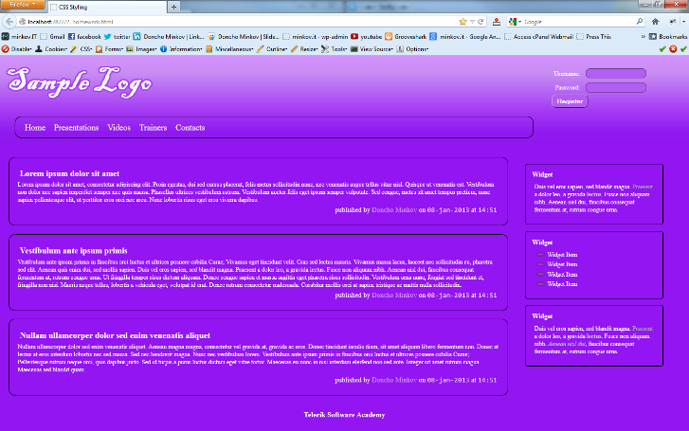
Homework
Implement the following using LESS
  Use the HTML code from homework.html
    Create the LESS easy to change (backgrounds, fonts)
    Use mixins for clears, gradients)

